Slide 1
Attitudes towards immigration in Europe, 2002 – 2016. Competition, integration, and values
Poland and its European context: Continuity and Change
Warsaw, February 21, 2018.
Kinga Wysieńska-Di Carlo and Zbigniew Karpiński (IPS PAS)

Slide 2
“ESS book” chapter
“Traditional” analysis of the attitudinal effects of socioeconomic position, changing contexts, and integration policies.
Data from seven rounds of the European Social Survey to illustrate patterns in responses to questionnaire items pertaining to immigration.
In general, our results challenged predictions of the competitive threat hypothesis, and were more consistent with normative theory of group relations, with its focus on integration policies.

Slide 3
 | Consequences | Oppose
Unemployment rate | -0.005 | 0.003
 | (0.012) | (0.005)
Net migration rate | -0.002 | 0.006
 | (0.012) | (0.004)
Work situation: In education × Net migration rate | -0.017*** | 0.005***
 | (0.005) | (0.002)
Work situation: Unemployed × Net migration rate | -0.010** | 0.001
 | (0.005) | (0.002)
Work situation: Retired × Net migration rate | 0.015*** | -0.005***
 | (0.004) | (0.002)
Work situation: Housework × Net migration rate | -0.011** | 0.004**
 | (0.004) | (0.002)
Work situation: Other × Net migration rate | -0.008 | 0.001
 | (0.008) | (0.003)
Observations | 225,686 | 225,686
Log Likelihood | -459,512.000 | -241,510.000
Akaike Inf. Crit. | 919,124.000 | 483,119.000
Bayesian Inf. Crit. | 919,641.000 | 483,636.000

Slide 4
Explanations of the immigrant attitudes
We used well-established theories explaining immigrant attitudes - that is, threat focused theories that utilise:
Individual level variables/threat – people do not like those who compete with them (or with the group to which they belong) for jobs or benefits or those who challenge their values/beliefs/group identifications, controlling for their ingrained norms (regarding equality, diversity, nation pride, etc.)
Group level variables/threats – attitudes of people with similar characteristics/of similar conditions/belonging to similar groups vary across countries that differ in economic development, the size of their immigrant populations, and the types of immigrant populations to which they are home (i.e. ethnic and skill composition of immigrants).
Group level dynamic threat – differences in attitudes across countries, and changes in attitudes within countries, may be explained by changes in contextual variables
Notes:
Sildes 4,5, and 6

Slide 5
Explanations of the immigrant attitudes cont.
We also took into account that competing theories predict different effects of the relative size of the immigrant population on attitudes:
Competitive threat predicts increase in negative attitudes with increase in influx/proportion of immigrants.
Still, more immigrants means more chances for inter-group contact, which is predicted to increase positive attitudes and at least mediate the effect of the size of immigrant population on anti-immigration attitudes.

Slide 6
The effect of migration and integration policies
Finally, we also took into account a relatively recent strain of research suggesting that different national-level migration and integration policies (regimes) may mediate between the size of immigrant inflow, economic conditions, and attitudes towards immigration.
Following other researchers, we used MIPEX score as an integration regime contextual variable.
As a side note – MIPEX is not as objective as Migration Policy Institute would like us to believe. It is actually heavily based on expert evaluations and experts in a given country use data of different quality and reports coming from different quality sources.

Slide 7
 | Consequences | Oppose
Unemployment rate | -0.022 | 0.010
 | (0.016) | (0.007)
Net migration rate | -0.021* | 0.008
 | (0.012) | (0.005)
MIPEX score | 0.015*** | -0.004**
 | (0.005) | (0.002)
Universalism × MIPEX score | 0.012*** | -0.004***
 | (0.002) | (0.001)
Observations | 124,036 | 124,036
Log Likelihood | -250,487.000 | -130,575.000
Akaike Inf. Crit. | 501,033.000 | 261,208.000
Bayesian Inf. Crit. | 501,315.000 | 261,491.000

Slide 8
Immigrant attitudes in the Visegrad countries
In the present study, we take a closer look at Visegrad countries
Historical and legal similarities – immigration regimes and path to citizenship – ius sanguinis (ius solis only in exceptional cases) – all those countries are very ethnically conscious
All have a history of being multiethnic states reduced to being a nation state not by their volition
All faced “fundamental questions of the continuity of citizenship in the face of such sweeping historical changes as territorial changes (Poland, Hungary), disintegration of federal states (Czech Republic, Slovakia), resettlement of ethnic groups or restoration of citizenship to persons deprived on ethnic or political grounds” (Kaźmierczak 2015)

Slide 9
Immigrant attitudes in the Visegrad countries – cont.
Looking at the trends in attitudes in Visegrad countries highlights the importance of looking at
Different initial conditions
Sources of perceived threat (as no actual influx of immigrants occurred in those countries)
Issues related to attitudes measurement

Slide 10
ESS and measurement of immigrant attitudes
In the ESS, attitudes towards immigration are measured using two blocks of items.
The first block is focused on subjective assessments of the consequences of immigration — for (a) the country’s economy, (b) its culture, and for (c) the country as a whole. Responses to the three items are combined into an index ranging from 0 to 10 with higher values indicating greater perceived threat.
The second block comprises three items asking respondents if their country should allow people (a) of the same ethnic background, (b) of a different ethnic background, (c) from poor countries outside Europe to come and live in the respondent’s country. Responses to the three items are also combined into a single index ranging from 1 to 4 with higher values indicating greater opposition to immigration.

Slide 11
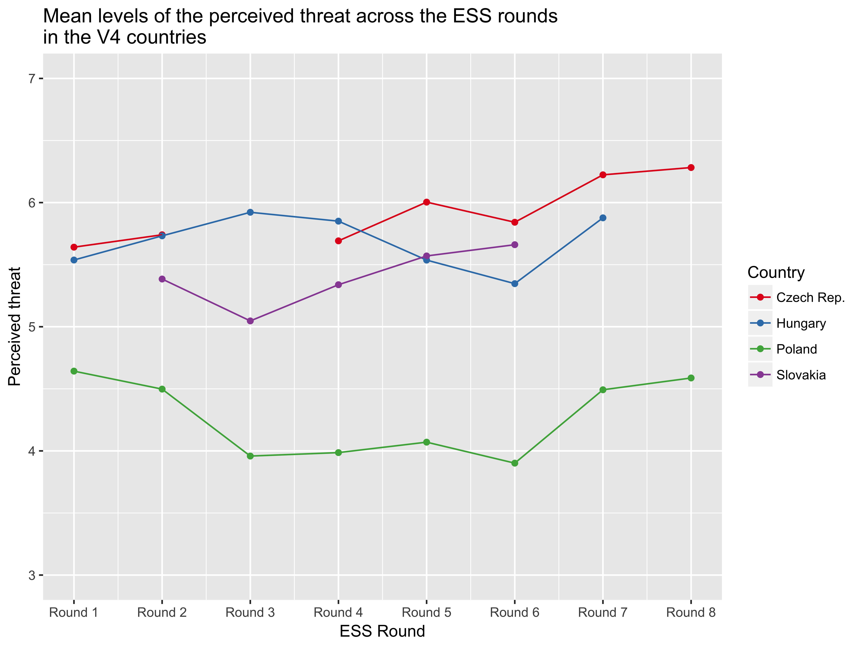

Slide 12
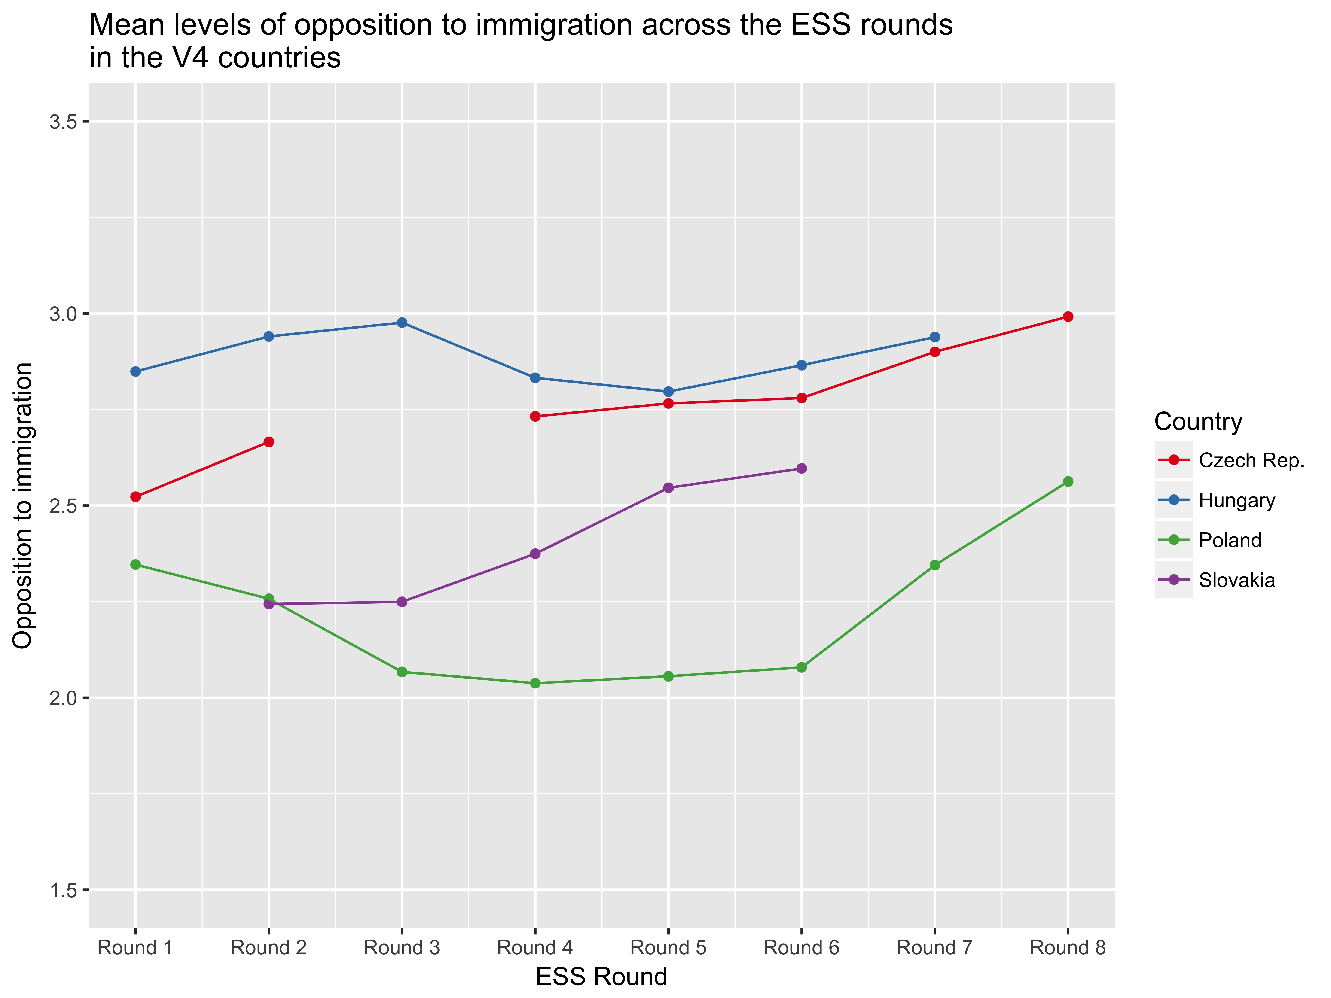

Slide 15
Discrimination tests in Poland
The ESS items are not a measure of behaviour towards immigrants — actual behaviour is not always consistent with attitudes or declarations of behaviour.
Between 2012 and 2014, a number of discrimination tests were conducted in Poland to study the extent of discrimination against immigrants in various markets.
The study of discrimination on the labour market – correspondence test using carefully matched letters applying for advertised jobs.
The study of discrimination in apartment renting – trained interviewers making telephone enquiries about availability and prices of apartments for rent.

Slide 16
Discrimination in hiring: net discrimination
Net discrimination | Estimate | Significance | Sample size
Against Ukrainians | 0.23 | <0.001 | 719
Against Vietnamese | 0.11 | <0.05 | 1,048

Slide 17
Conclusions
Presented analyses are preliminary
Size of ethnic minorities and minority relations might be more important for shaping immigration attitudes and perceived threat than % of foreign born population
Measures for contextual variables – different sources provide different values for contextual variables
Meaning of the term immigrant may vary across countries – e.g. Polish government repeatedly refers to Ukrainian labour migrants as refugees; also (as demonstrated in previous studies) opposition to immigration has a racist component

